Slide 1
Digital Marketing Portfolio
Shazana Shamsul Bahar

Slide 2




Malaysia’s Digital Landscape in 2020
TOTAL POPULATION
MOBILE PHONE
CONNECTIONS
INTERNET
USERS
ACTIVE SOCIAL
MEDIA USERS
32.16
MILLION
40.69
MILLION
26.69
MILLION
26.00
MILLION
URBANISATION:
76%
vs. POPULATION:
127%
PENETRATION:
83%
PENETRATION:
81%

Slide 3

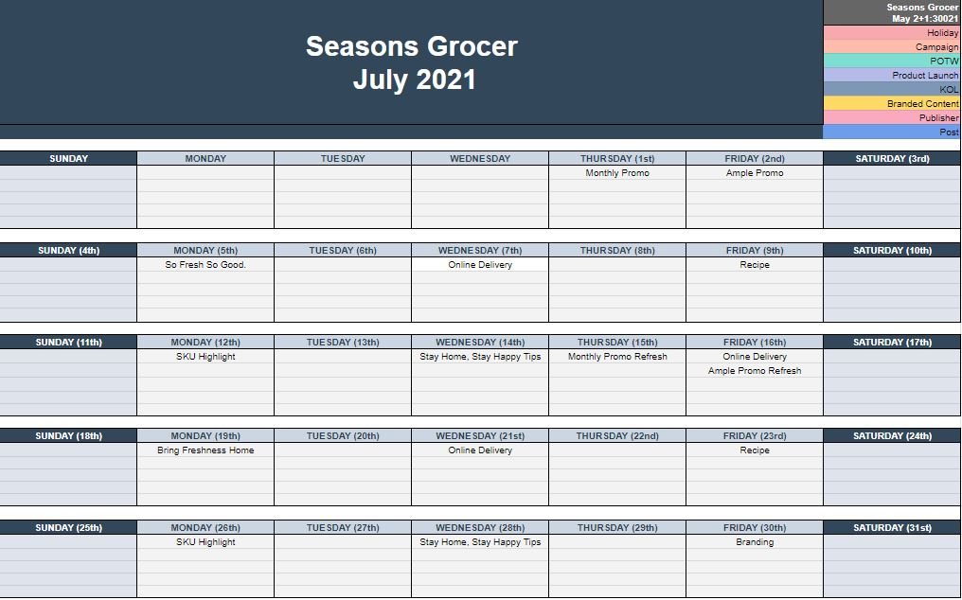

Social Media Management
SAMPLE OF SOCIAL MEDIA CONTENT CALENDAR

Slide 4
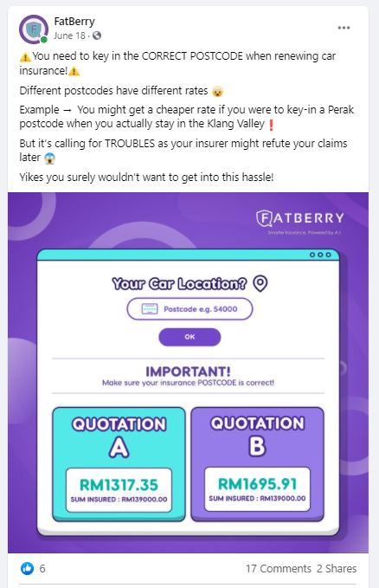
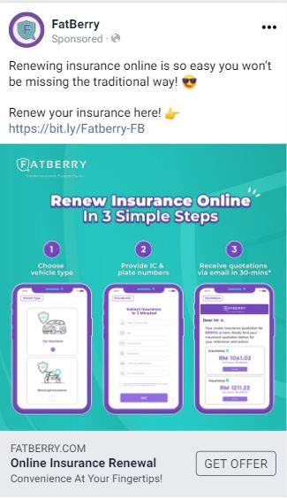


Social Media Management
EDUCATIONAL

Slide 5


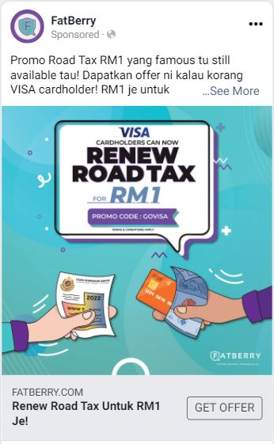

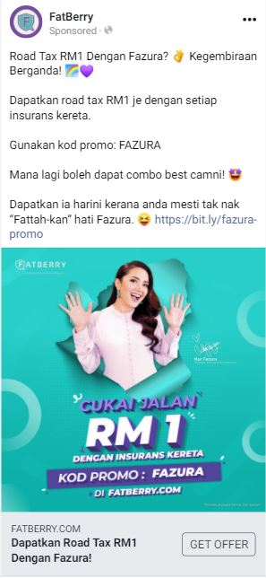
Social Media Management
PROMOTIONS

Slide 6

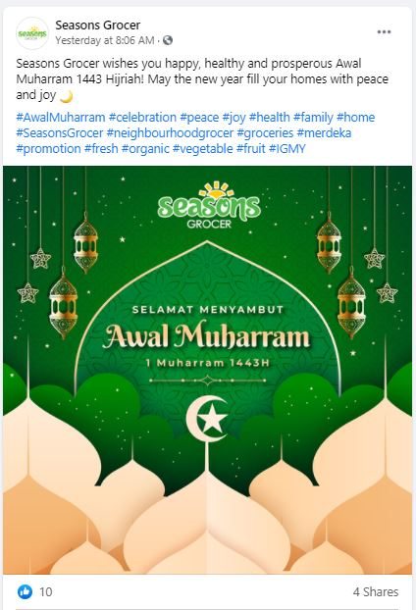
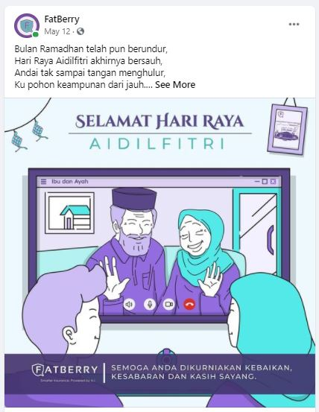
Social Media Management
GREETINGS

Slide 7

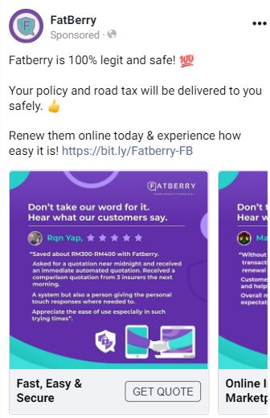
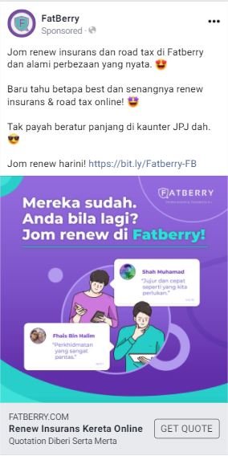
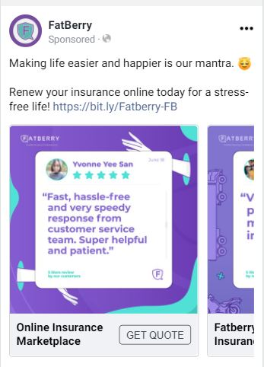
Social Media Management
TESTIMONIALS

Slide 8

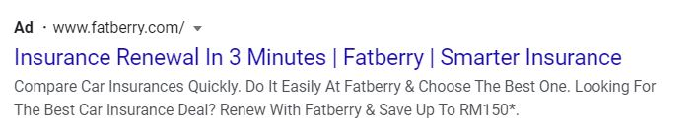

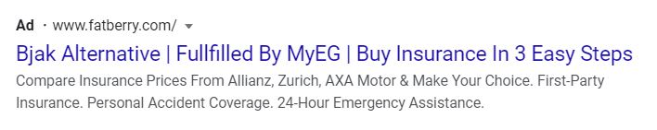
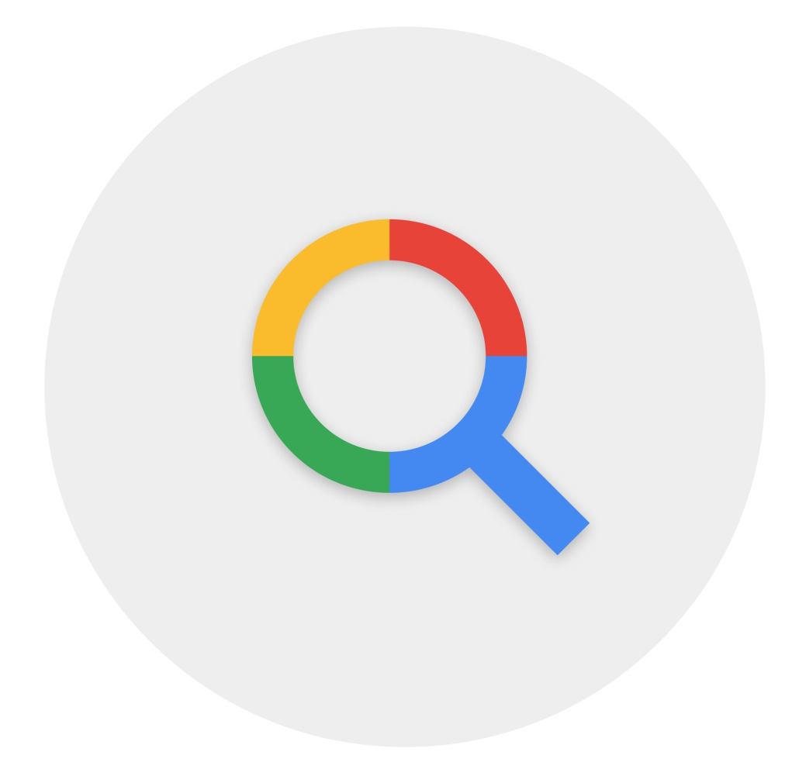

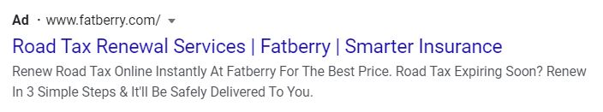
Google Ads
Search Engine Marketing (SEM)
Ad group: Brand (Fatberry)
Ad group: Competitors
Ad group: Product category (road tax)

Slide 9

Digital Marketing Objectives
Awareness
Consideration
Conversions
Brand Awareness
Reach
Website Traffic
Engagement
App Installs
Video Views
Lead Generation
Messages
Conversions
Catalog Sales
Store Traffic (physical)

Slide 10




Email Marketing
Malaysia reports to have one of the highest open rate of email marketing behaviour than the average Asia’s statistics.
Open rate: 24.33%
CTR: 3.21%
Click-to-open rate: 13.2%
Unsubscribe rate: 0.14%
Spam rate: 0.01%
ONE TIME OFF
Seasonal greetings
Birthday EDMs
Promotions
New products
Holiday specials
AUTOMATIONS
Welcoming EDMs
Hot leads
Reminders
Re-orders
Nurturing EDMs
Warm leads
Cold leads

Slide 11
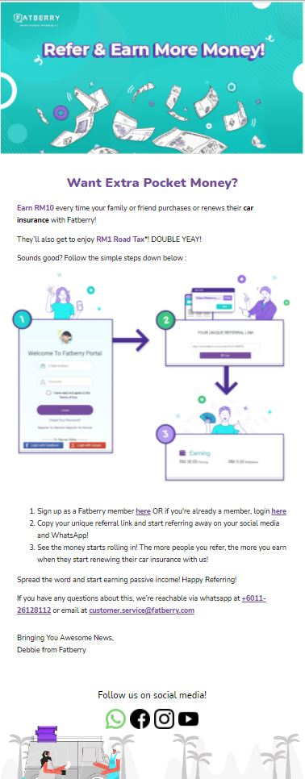
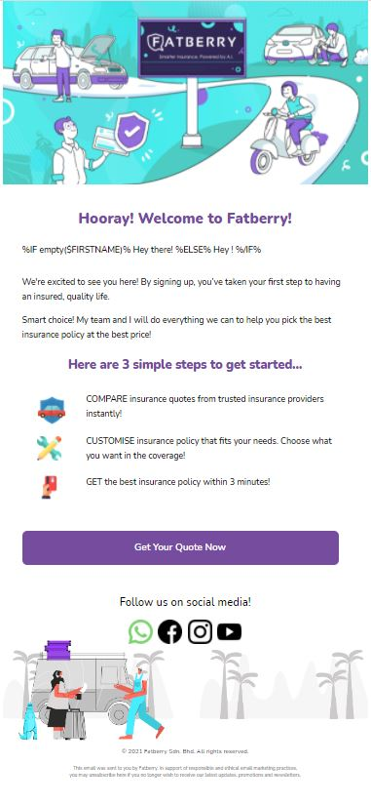
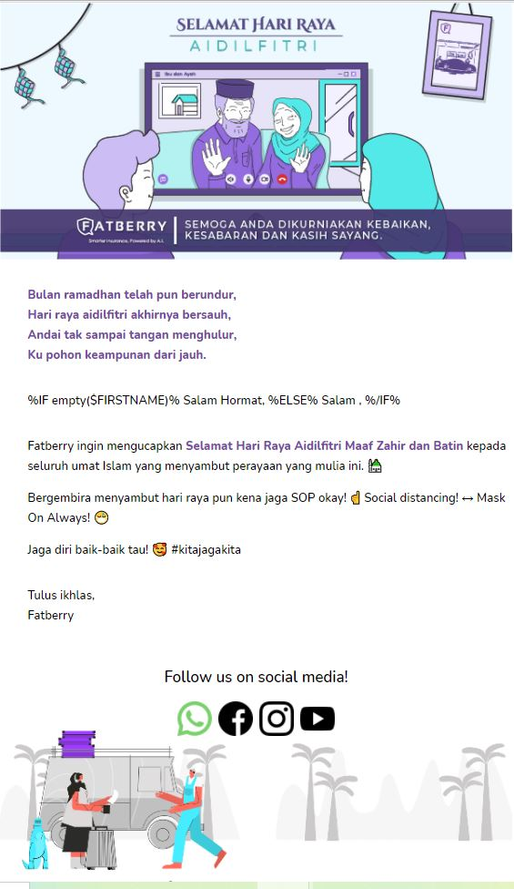
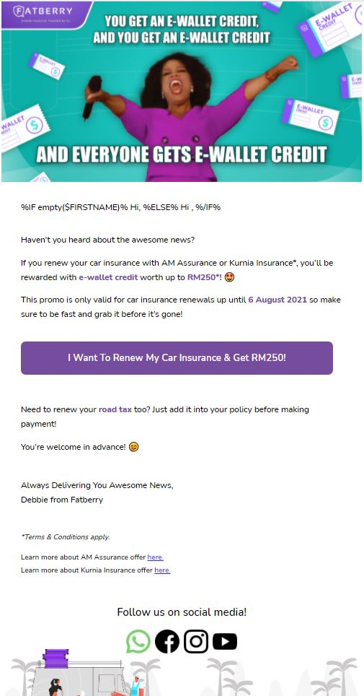
Email Marketing

Slide 12
The End.
Thank You.

